Slide 1
Democracy at Work
ETUI Unit 1 – Workers’ Participation
De Spiegelaere Stan, Hoffmann Aline, Jagodzinski Romuald, Lafuente Hernandez Sara
2019

Slide 2
Notes for presenters
[This slide is hidden and will not be shown when presenting]
This presentation includes supporting material for the ETUC's campaign on democracy at work.
The presenters are free to use this presentation taking the following into account:
Every slide contains some notes on the source of the presented data. Slide 3 with quotes is an image, but in the notes section it contains all the quotes in text + sources.
You can freely decide to skip any slide or insert a slide of your own
You cannot change the content of the slides
If you add a slide, please do not include the ETUI logo
More information and explanation about the data and graphs can be found in Benchmarking Working Europe 2019.

Slide 3
Source: authors’ own compilation, 2019
Notes:
Quotes references:
“For a democratic polity to exist it is necessary for a participatory society to exist, i.e. a society where all political systems have been democratised and socialisation through participation can take place in all areas. The most important area is industry”, Pateman, Carole (1999) [1970] Participation and Democratic Theory. Cambridge University Press. (p.43)
“The question is whether or not workers should be citizens in economic life as they are in political life”, Ernst Wigforss, (1981) Skrifter i urval, Tiden, Stockholm, 1981, vol. V, p. 38, quote after: Davis E. And Lnasbury R. (eds.) (1986) Democracy and control in the workplace, Longman Cheshire.
3. “If we fail to [democratize the corporation], we will be forced to a standstill, from which we will see capitalism eat up what is left of political democracy”
[E]mployees are suffering from the tension between their aspiration to greater voice in the workplace and the authoritarian power structures that continue to hold sway there”, Ferreras, Isabelle (2017) Firms as Political Entities. Saving Democracy through Economic Bicameralism. Cambridge University Press: Cambridge. (p.4 and p.8)
4. “Political and social participation has intrinsic value for human life and well-being. To be prevented from participation in the political life of the community is a major deprivation”, Sen, Amartya (1999) « Democracy as a universal value”, Journal of Democracy 10(3): 3-17
5. “Citizens cannot spend eight or more hours a day obeying orders and accepting that they have no rights, legal or otherwise, to participate in important decisions that affect them, and then be expected to engage in robust, critical dialogue about the structure of our society. Eventually the strain of being deferential servants from nine to five diminishes our after-hours liberty and sense of civic entitlement and responsibility”, (Elaine Bernard, 1996:2, quoted in Isabelle Ferreras, 2017 :154): Elaine Bernard (1996) Why Unions Matter. New Jersey: Open Magazine Pamphlet Series, 1-5.
6. “However, a vast majority of Americans livea paradox: they check their deeply held democratic rights at the door every day when they show up for work. That is because the rules and rights associated with democracy only apply to people’s relationship to their government, not their employer. Citizens in a democracy remain subjects in the workplace — the place where most adults spend a large part of their waking hours.”, Barry Eidlin and Micah Uetricht Freedom From the Boss, https://jacobinmag.com/2018/01/freedom-from-the-boss
7. “The subordination of everything to the single aim of monetary profit leads industrial government to take the form of absolute monarchy. Monarchy has a certain simplicity and convenience; but in the long run it is seldom the best for all concerned. Sooner of later it leads to insurrections.”, (Morris R. Cohen, 1927:28, quoted in Isabelle Ferreras, 2017 :154). Morris R. Cohen (1927) “Property and Sovereignty”. The Cornell Law Quarterly 13:8-30.
8. “The present authoritarian structure of workplaces means that the majority of the population spends the majority of their lives in associations that are severely undemocratic and hierarchical, yet we unhesitatingly call our societies “democracies.”
&
“In particular, workplaces have the potential to be much more deeply democratic than states because they are much smaller and so have much more scope for direct participation and therefore more possibility for meaningful self-determination." , Malleson (2014) After Occupy. Economic Democracy for the 21st century, Oxford University Press
9. “(...) a struggle for the democratization of the economy requires a new, imaginative – indeed utopian – counter-offensive: a persuasive vision of a different and better society and economy, a convincing alternative to the mantra of greed, commodification, competitiveness and austerity, a set of values which connects with everyday experience at the workplace and in the community. This is necessarily an international struggle, and requires international solidarity.”, Rebecca Gumbrell-McCormick and Richard Hyman (2018) “Democracy in trade unions, democracy through trade unions?”, Economic and Industrial Democracy, [First published] 1-20 (p.17)
10. “If democracy is justified in governing the state, it must also be justified in governing economic enterprises”, Dahl A. Robert (1984) Democracy in the Workplace
Robert A. Dahl Winter 1984 in: Dissent Magazine.
11. “Those who work in the mills ought to own them, not have the status of machines ruled by private despots who are entrenching monarchic principles on democratic soil as they drive downwards freedom and rights, civilization, health, morals and intellectuality in the new commercial feudalism.”, Lowell Mill Girls (1840), quote after: Elliot M. (2011) On the Mind and Freedom, p. 338

Slide 4
“Great minds” on democracy at work
“The very conception of democracy will have to be widened, so as to include economic as well as political relations”. (Sidney and Beatrice Webb, (1902) [1897], Industrial Democracy. London: Longmans, p.840)
“Personally, I'm in favor of democracy, which means that the central institutions of society have to be under popular control. (...) Just as I'm opposed to political fascism, I'm opposed to economic fascism. I think that until the major institutions of society are under the popular control of participants and communities, it's pointless to talk about democracy.” (Noam Chomsky (2004) Language and Politics, p. 138)
“(…) I would propose a system which is democratic. Meaning that, it's long been understood -- in fact it's been a cliche, it has nothing to do with the left in fact, it's right through the American working class movement, you know, social thinkers, everybody, forever -- that you don't have democracy unless people are in control of the major decisions. And the major decisions, as has been long understood, are investment decisions, fundamentally investment decisions, what you do with the money, what happens in the country, what's produced, how is it produced, what are working conditions like, where does it go, how is it distributed, where is it sold. I mean, that whole range of decisions, that's not everything in the world, but unless that range of decisions is under democratic control, [what] you have is one or another form of tyranny.” (Noam Chomsky, interview in Learn to Educate)
Notes:
Sidney and Beatrice Webb, (1902) [1897], Industrial Democracy. London: Longmans (p.840): “The very conception of democracy will have to be widened, so as to include economic as well as political relations”.
Noam Chomsky (2004) Language and Politics, AK Press, ISBN1902593820, 9781902593821
Chomsky interview with David Barsamian (Alternative Radio), as quoted by Learn to Educate. A quarterly on Education and Development, Issue No. 3, Vol. no. 1, 2002, p. 17 ff.

Slide 5
“Great minds” on democracy at work (2)
“Democracy does not exist unless it exists in the workplace.”, Richard D. Wolff, Twitter https://twitter.com/profwolff/status/929030710614265856
“There is no reason why the principles of democracy should stop at the time we clock on for work.”, John McDonnell, New Socialist
“The mass of people in our economic system are required to live with the consequences of the decisions made by the corporate leaderships. Decisions for which they are excluded. Legally and in practice.” (Richard D. Wolff "Democracy at Work: A Cure for Capitalism“, Talks at Google)
Notes:
Richard D. Wolff, Twitter https://twitter.com/profwolff/status/929030710614265856
John McDonnell, New Socialist https://newsocialist.org.uk/when-we-go-into-government/

Slide 6
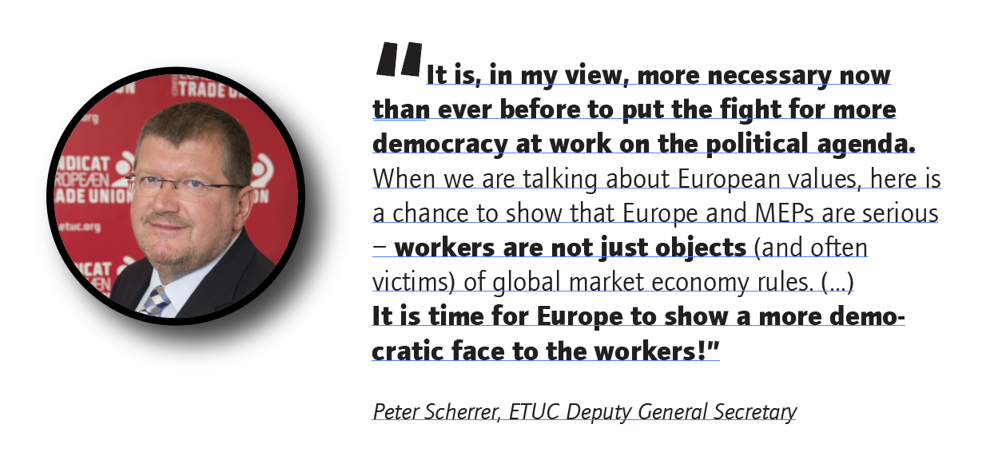
Source: Scherrer P. (2018) More democracy at work? Do we need that? in: www.socialeurope.eu
Notes:
More Democracy At Work? Do We Need That?
by Peter Scherrer on 8th March 2018
Social Europe
https://www.socialeurope.eu/m
“It is, in my view, more necessary now than ever before to put the fight for more democracy at work on the political agenda. When we are talking about European values, here is a chance to show that Europe and MEPs are serious – workers are not just objects (and often victims) of global market economy rules. Workers should take a close look at which parties include more democracy at work in their EP election manifestos. European trade unions have supported, right from the beginning, the European idea, the deepening and enlargement of the Union. It is time for Europe to show a more democratic face to the workers!”
Peter Scherrer, Deputy General Secretary of ETUC
ore-democracy-at-work-do-we-need-that

Slide 7
Practitioners on democracy at work
“More than ever, we need our rights to be involved at the early stages of those restructuring plans enforced and strengthened, as this is the only way to socially responsible anticipation and management of change”,
“We have supported and coordinated trade union and worker representatives in more than 600 multinational companies, including via European Works Councils, for more than 30 years. Against this practical experience, we can assert that it is no longer time for nice guidelines, handbooks or other soft measures. If European policy-makers are really serious about ensuring that our rights to a voice in company decisions are fully effective and enforced, then there is only one avenue to pursue: legally-binding initiatives to strengthen democracy at the workplace. This means substantial changes in the EWC Directive, substantial improvement in the Company Law Package, and finally, the adoption of a horizontal framework for workers’ right to information, consultation and participation to apply to all multinational companies making use of EU company law instruments”.
Luc Triangle, industriAll European Trade Union General Secretary.
Notes:
More Democracy At Work? Do We Need That?
by Peter Scherrer on 8th March 2018
Social Europe
https://www.socialeurope.eu/more-democracy-at-work-do-we-need-that

Slide 8
Content
Why do we need democracy @ work?
What should we understand by democracy @ work?
Transnational democracy @ work
What are the ETUC demands?

Slide 9
D@W strenghtens political democracy
Democracy at work and political democracy are mutually reinforcing
People who are invloved in company decisions making vote more, are more interested in politics and see themselves as more able political citizens.
Notes:
Source: Based on the European Social Survey 2016.
Note: Democracy at work scale based on mean scores of wkdcorga (allowed to decide how daily work is organized) and iorgact (allowed to influence policy decisions about activities of organization). Reported differences between mean score less than 2.5 and more than 7.5.
Ability to influence politics based on psppsgva taking together ‘completely’, ‘very’ and ‘quite’.
Interested in politics based on polintr taking together ‘very’ and ‘quite’.

Slide 10
Why? D@W means better jobs
Democracy at work goes hand in hand with higher quality jobs (Piasna, 2017) and more life satisfaction.
Countries with high democracy at work tend to have higher wages.
Notes:
Source: Piasna (2017). Democracy at work originally titled ‘collective interest representation’. Score of: collective bargaining coverage, trade union density and employees covered by works council or similar institution. Wages: average net monthly wage from main paid job, adjusted for PPP, in euros.
Source life satisfaction: European Social Survey (2016). Democracy at work scale based on mean scores of wkdcorga (allowed to decide how daily work is organized) and iorgact (allowed to influence policy decisiosn about activities of organization). Reported differences between mean score less than 2.5 and more than 7.5.

Slide 11
Why? D@W equals high productivity and employment
Notes:
Productivity;
Source: x-axis: European Participation Index (2013). Y-axis : OECD (2013): GDP per hour worked in USD, 2010 PPPs.
Employment rate:
Source: X-axis: European Participation Index (2013). Y-axis : Eurostat (lfsa_ergan): Employment rate (20-64 y), figures for 2013.

Slide 12
Why? D@W keeps inequality at bay
Notes:
Source: European Participation Index and GINI (Eurostat, 2013).

Slide 13
Why? D@W is good for your health
Companies with works councils and/or Health and safety representatives have more elaborate H&S policies
Notes:
Source: Esener 2014, authors calculations based on Q166 (representation), Q155, Q250, Q163 and Q303. Weighted data.

Slide 14
Why? D@W for more sustainable companies
Companies with BLER score higher on many indicators regarding sustainabiliy

Slide 15
But really, why D@W?
Fundamental right to self-determination
Democracy in all spheres of life
Stakeholders matter more than shareholders
Owning a company shouldn’t mean absolute control
Equality, also in companies

Slide 16
What should be understood by D@W?
The content matters
The shapes can be diverse
- It should give employees a degree of control over their work and the company
- It should increase democratic oversight over companies, public services and the economy, at all levels and in different topics.
- It should increase the voice of the workers in companies and the economy in an inclusive way and on time.
- Direct vs. Indirect
- Workplace, company, group, sector, national, european or global level
- Focused on working conditions or strategy
- Rights and institutions
- Can happen in different timings

Slide 17
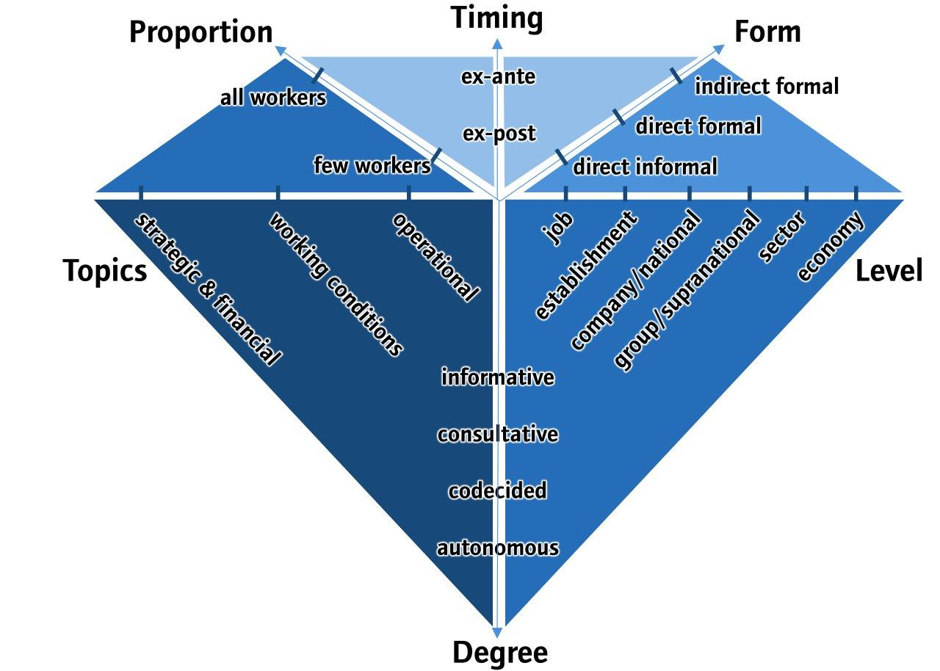
The Diamond of Democracy at Work
Source: authors’ conceptualization based on Conchon 2014: 72-97, Van Gyes, 2006; Marchington, 2005:26-29, Knudsen, 1995:9, Gold and Hall, 1990:25, Davis and Lansbury, 1986:2
Notes:
The proposed analytical framework allows to assess the quality and intensity of ‘democracy at work’ arrangements in a country or a specific company. In principle, the bigger is the area covered by one or several diamonds, the richer are democracy at work arrangements.
However, a full evaluation of their potential in practice requires to consider 1) the articulation/coordination between all the « diamonds » overlapped in a particular scenario 2) the institutional, political and economical broader context in which they can be developped. The « diamond » analytical framework does not allow to assess these two variables.

Slide 18
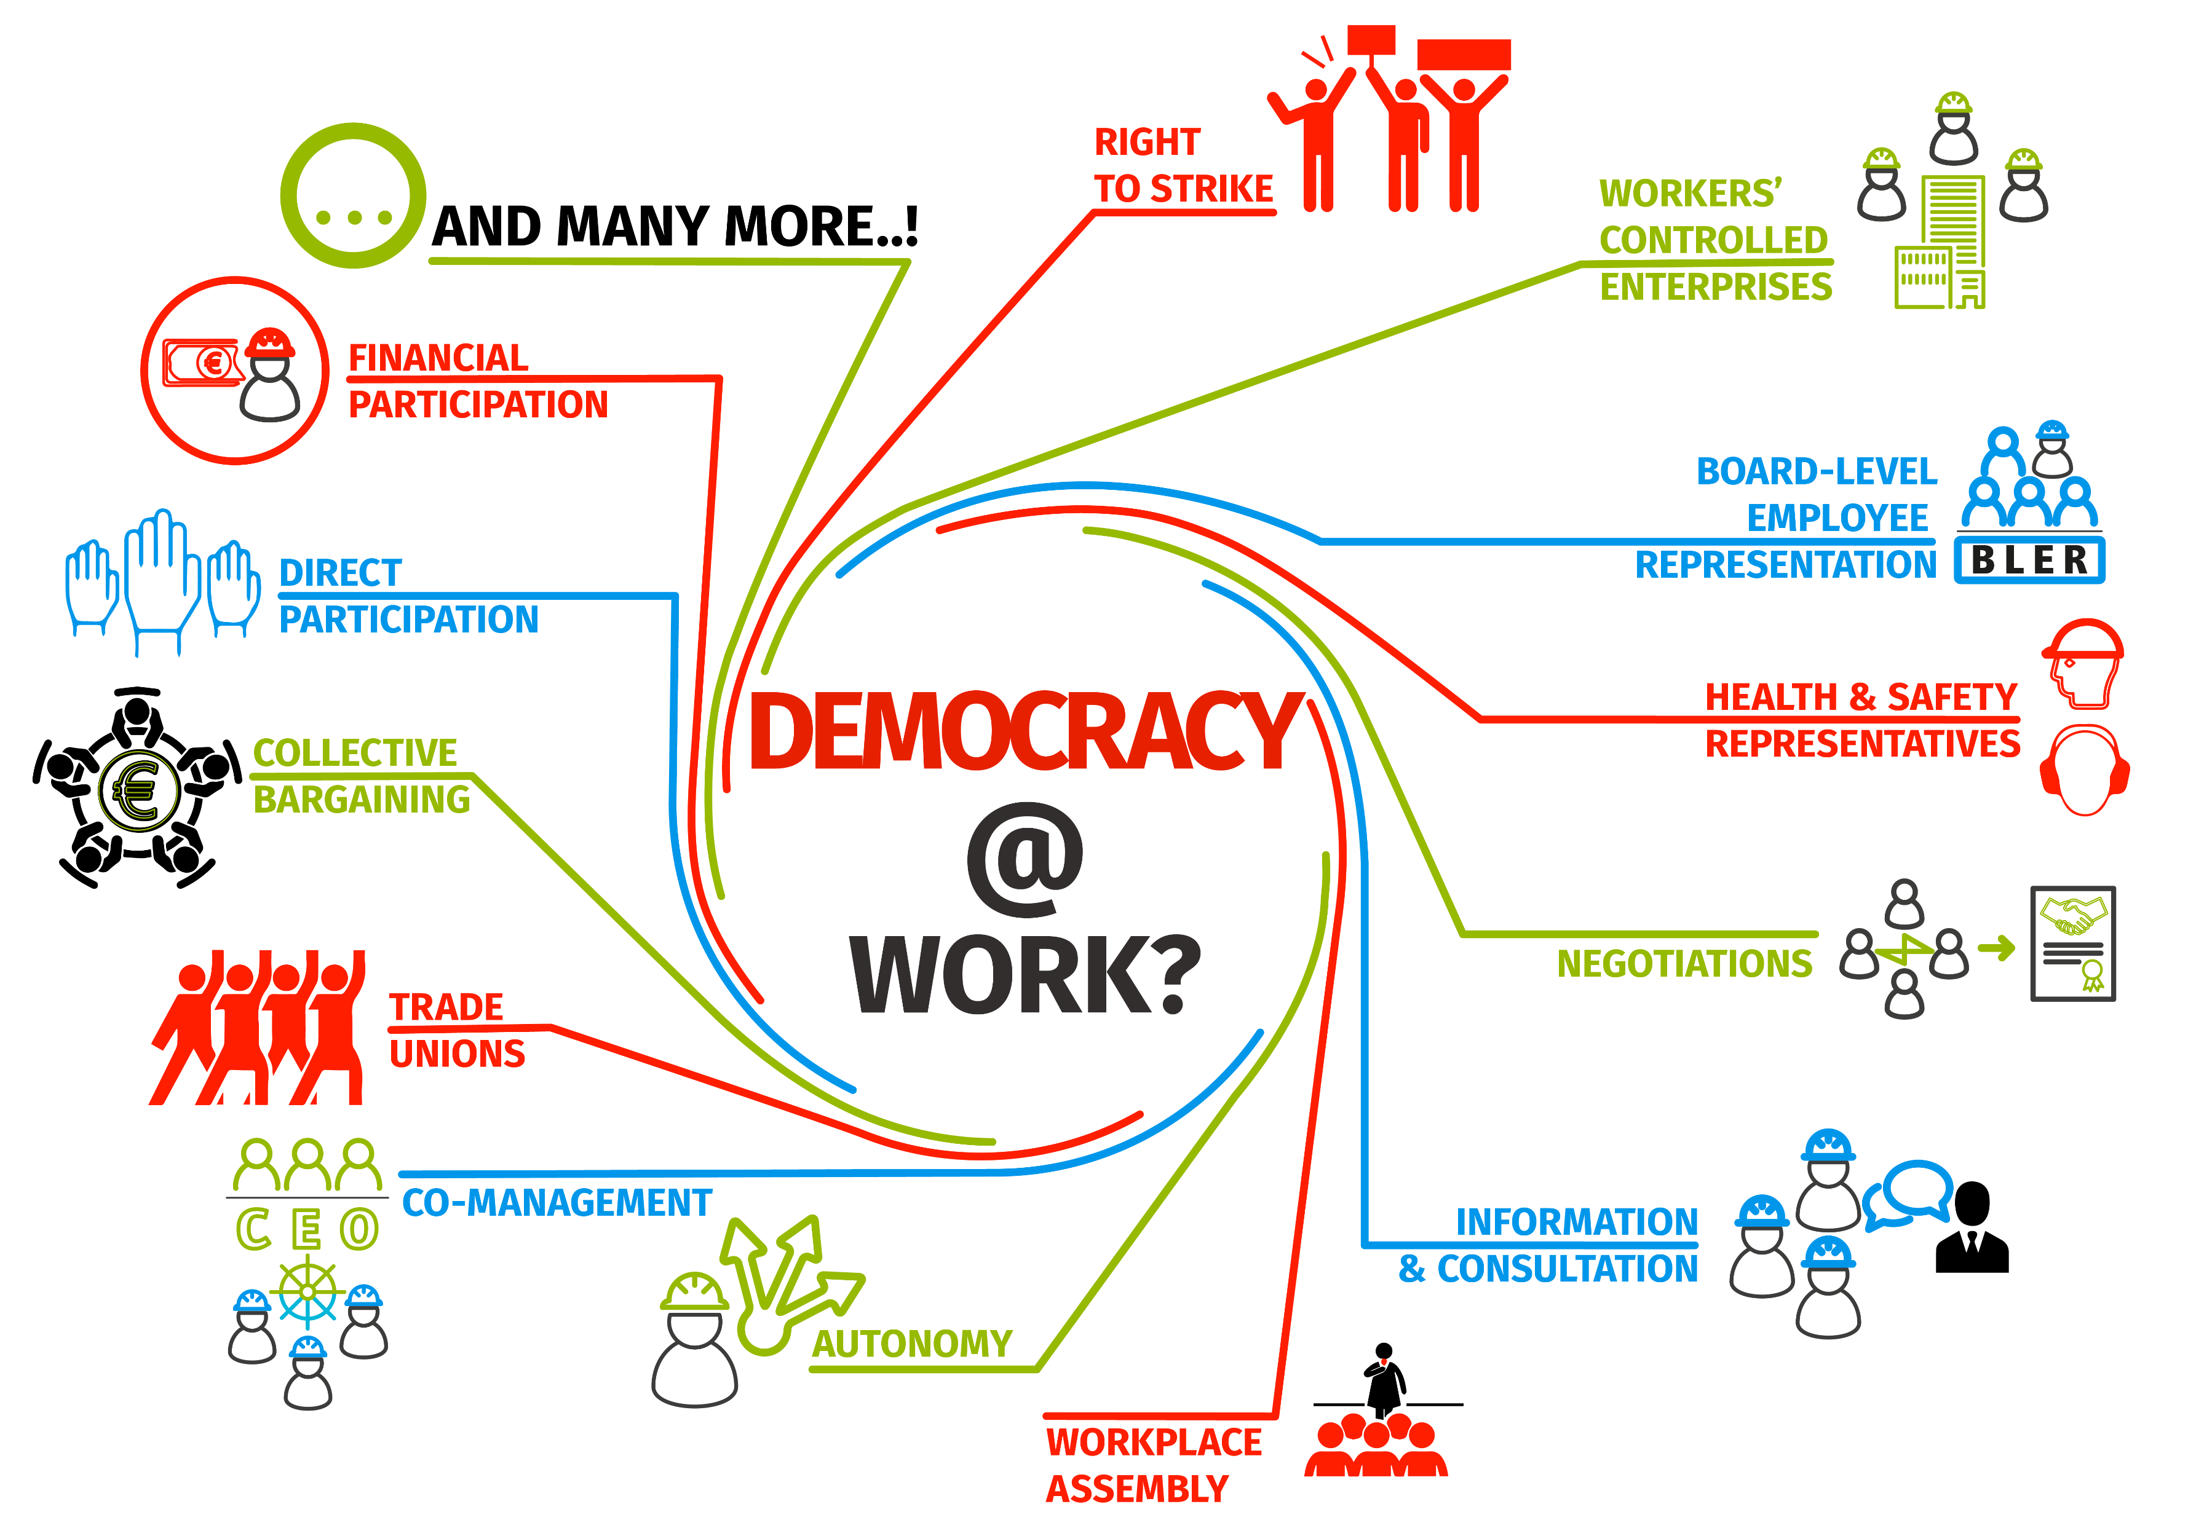
Source: Benchmarking Working Europe 2019.

Slide 19
Why? D@W as a critical part of company sustainability
Source: Vitols S. (2011) The sustainable company, ETUI (adapted).
Notes:
Source: S. Vitols (ed.) ‘The sustainable company’, ETUI, Brussels

Slide 20
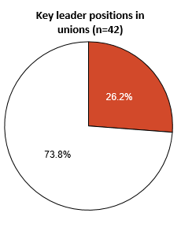
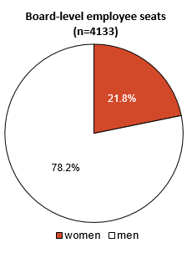
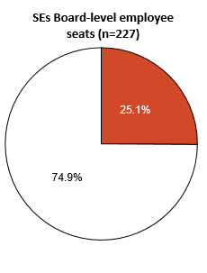
Women in representative positions: 1/4
Source: ETUC 11th Annual Gender Equality Survey (2018); Waddington and Conchon (2016:79); EWPCC Database on SE board-level employee representatives, accessed December 2018
Notes:
A sound democracy at work requires democratic and inclusive representative institutions at work. This means, among other things, including women in representative positions at work.
Although progress is definitely observed in gender equality in political representation, particularly in key leader positions in union organizations and SE board-level employee seats, women still occupy around one fourth of representative leadership positions. More needs to be done so that gender equality can also be preached from democratic representative institutions at work.

Slide 21
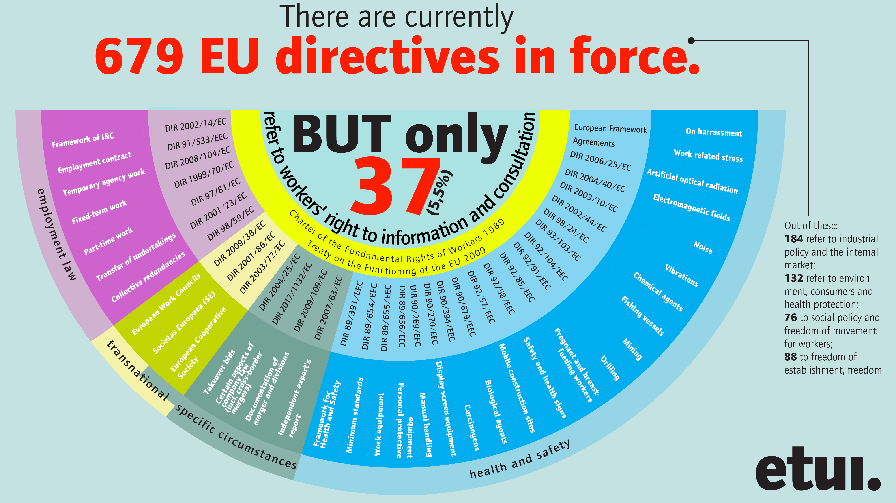
The limited palette of workers’ rights
Source: Jagodzinski R. and Hoffmann A., ETUI 2019.

Slide 22
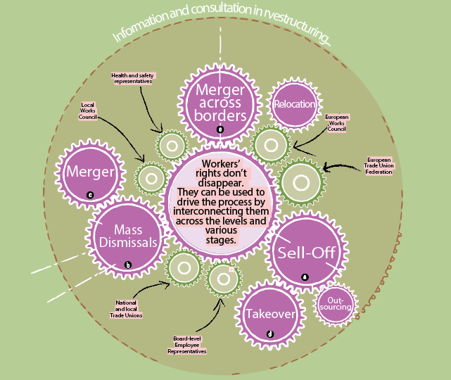
Workers’ rights in restructuring
In restructuring, employee representatives have the right to know all about the restructuring plans, the steps, and their potential consequences.
Using these rights can avert workers being played off against one another.
By combining local and transnational rights workers’ reps are far better equipped to handle restructuring.
Source: Jagodzinski R. and Hoffmann A., ETUI 2019.

Slide 23
Transnational Democracy @ Work
European Works Councils
Board level employee representation (BLER) in european company (SE) agreements
BLER is Europeanizing:
25 SE agreements (43%) provide for international representation, and 30 (52%) make it possible.
This allows more inclusive representation in SE boards.
Source: ETUI (2018) SE agreements’ BLER provisions database (as of 1 February ).

Slide 24
ETUC demands
Source: ETUI own compilation based on ETUC
Notes:
Sources:
ETUC position on the proposed consolidation of the three Directives on information & consultation, collective redundancies and transfer of undertakings. Adopted at the Executive Committee Meeting of 3-4 December 2013 (https://www.etuc.org/sites/default/files/Final_Position_on_consolidation_of_directives_EN_1.pdf).
ETUC position paper: For a modern European Works Councils (EWC) Directive in the Digital Era (https: //www.etuc.org/documents/etuc-position-paperfor-modern-ewc-directive-digital-era#)
ETUC Resolution adopted at the Executive Committee Meeting of 7- 8 March 2018: Strategy for more democracy at work (https://www.etuc.org/documents/etuc-resolution-strategy-more-democracy-work-0#)
ETUC Position paper adopted at the extraordinary ETUC Executive Committee on 13 April 2016 in The Hague and the ETUC Executive Committee on 9 June 2016 in Brussels: Orientation for a new EU framework on information, consultation and board-level representation rights (https://www.etuc.org/documents/etuc-position-paper-orientation-new-eu-framework-information-consultation-and-board-level#)
ETUC position paper adopted at the Executive Committee meeting on 25-26 June 2018. The new company law package 2018: A missed opportunity for more democracy at work (https://www.etuc.org/en/document/etuc-position-paperthe-new-company-law-package-2018-missed-opportunity-more-democracy-work)
ETUC position adopted at the Executive Committee Meeting of 14-15 December 2016: Protecting Workers in the context of the Commission Proposal for a Directive on Preventive Restructuring, Second Chance, Insolvency and Discharge Procedures (https://www.etuc.org/en/document/etuc-position-protecting-workers-context-commission-proposal-directive-preventive)
https://www.etuc.org/en/document/towards-new-framework-more-democracy-work-etuc-resolution
Key messages:
· The ETUC calls for a Directive introducing a new and integrated architecture for workers’ involvement in European company forms. Building on the existing EU acquis, the Directive should set high standards on information and consultation, and introduce ambitious minimum standards on workers’ board level representation as an additional source of workers’ influence.
· The Directive would become the overarching reference on workers’ rights to information, consultation and board level representation for all European company forms. The new Directive would accommodate the existing acquis on information and consultation (e.g.: Directive 2002/14/EC) and not replace it.
· A Directive on rights to information, consultation and workers’ board level representation applicable to all European company forms would address the gaps and loopholes in the EU acquis. Above all, by demanding such a Directive the ETUC is proposing a truly European vision for EU company law. The Union needs to send strong signals that it defends a business model based on social justice and sustainability.
· Prerogatives of trade unions are key and should be secured throughout the Directive.

Slide 25
References and sources
Conchon A. (2014) Les administrateurs salariés en France : contribution à une sociologie de la participation des salariés aux décisions de l’entreprise, PhD dissertation under the supervision of Michel Lallement and Annette Jobert, Paris : Conservatoire national des Arts et Métiers
ETUC 11th Annual Gender Equality Survey (2018)
Eurostat (2013)
ETUI database of EWCs and SE works councils, www.ewcdb.eu
ESENER Round 2: European survey of enterprises on new and emerging risks (2014).
ESS Round 8: European Social Survey Round 8 Data (2016). Data file edition 2.1. NSD - Norwegian Centre for Research Data, Norway – Data Archive and distributor of ESS data for ESS ERIC.
OECD Database (2013)
Piasna, A. (2017). “Bad jobs” recovery? European Job Quality Index 2005-2015 (ETUI working paper No. 2017.06) (p. 43). Brussels: European Trade Union Institute.
Vitols, S. (2011) The Sustainable Company, ETUI, Brussels.
Vitols, S. (2013) European Participation Index
Waddington J. and Conchon A. (2016) Board Level Employee Representation in Europe, ETUI, Brussels
EWPCC Database on SE board-level employee representatives, accessed December 2018
More information and explanation about the data and graphs can be found in Benchmarking Working Europe 2019.

