Slide 1
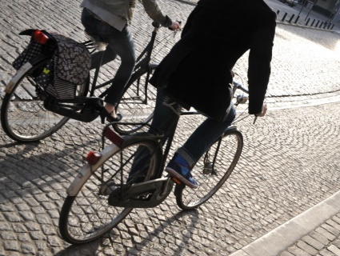

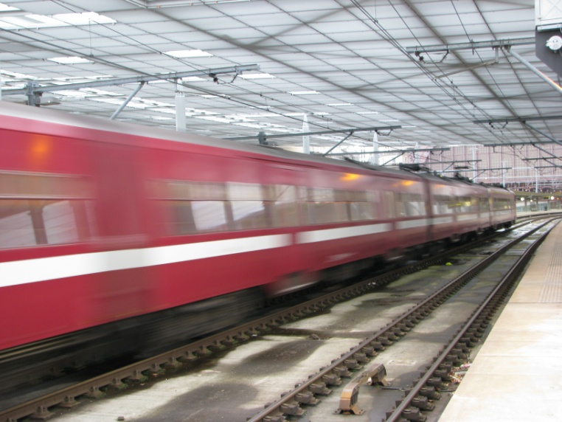
Promoting Sustainability through Mobility Management
Concepts, Belgian Experience
Bart Desmedt
General manager Traject

Slide 2
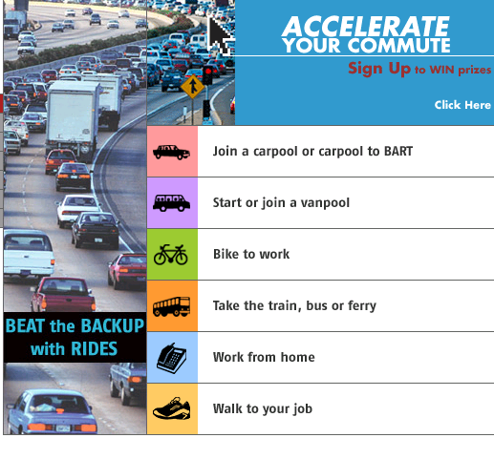
Origin of mobility management
The European version of “Transportation Demand Management” (TDM)
Origin in the States in the 80ies
  “Clean Air Act”: companies have obligation to implement measures for decreasing car use
  →company transportation plans
  → transport management associations (TMA)
  supply solutions like car- and vanpooling, bus services, teleworking etc…
Imported in Europe in 1991: program “transportation management” in Holland based on the US concept,
Adopted in Belgium in 1992

Slide 3
The essence of mobility management
Integrating the demand side in transport planning
  bottom up approach
  → inter-activity
  work with target groups
  → tailor made solutions
Soft measures to complete hard measures

Slide 4

Before mobility management: the top-down approach
Sender
Receiver

Slide 5
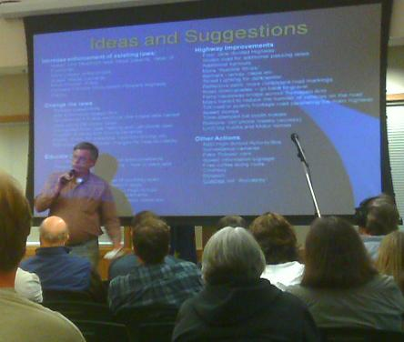
Mobility management
Inter-activity

Slide 6
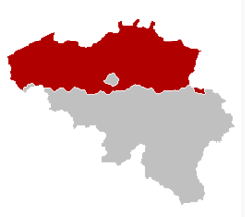

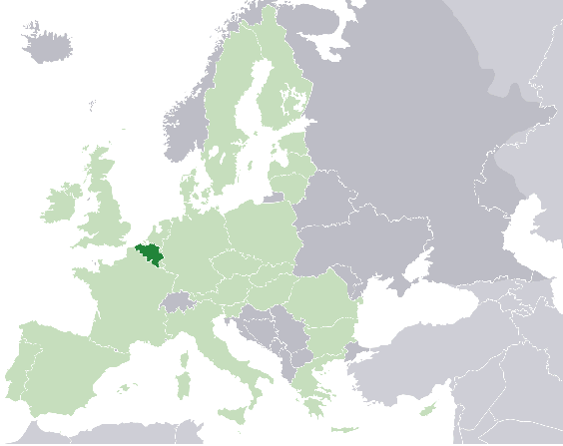
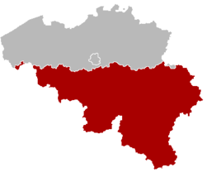
Belgium
Flanders
6 mill.
Brussels
1 mill.
Wallonia
4 mill.

Slide 7
National framework for home-work traffic
Obligation for companies > 100 employees to deliver mobility data every three years
Since 1998: fiscal framework in favour of sustainable transport in home-work traffic
  Cycling reimbursement (commuting or business trip): tax free up to €0,22/km)
  Bike offered by the employer and investments in bicycle infrastructure: tax free for workers, 120% deductible for employer
  Public transport reimbursement: 100% tax free
  Fiscal bonuses for carpoolers and company bus users
  CO2-dependant taxation of company cars

Slide 8

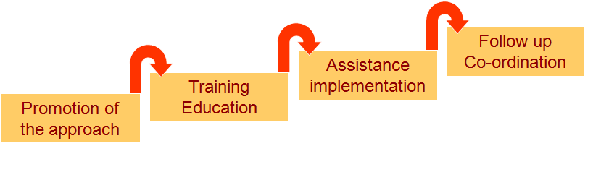
Regional home-work mobility policies
Flanders “Commuting plan”: integrated multi-stages policy
Brussels:
  compulsory commuter plan for companies over 100 employees
  assistance to companies, follow up of plans
→ multiplication of continued mobility management initiatives
Provincial “Mobidesks”: full assistance to companies
Flemish Region “Commuting fund”: up to 50% financing of transport solutions
focus on “access to work”
Flemish Foundation for Traffic Studies
Including trainings for workers unions

Slide 9
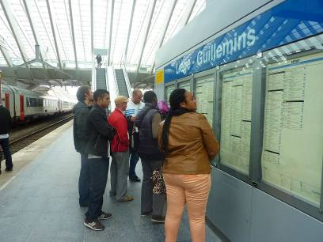
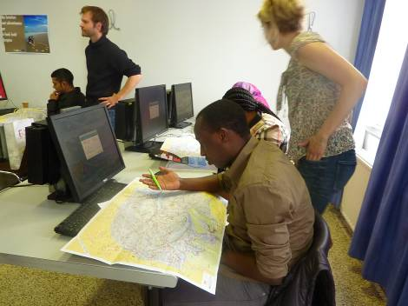
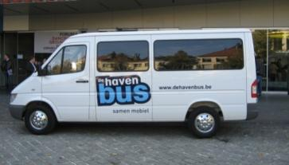
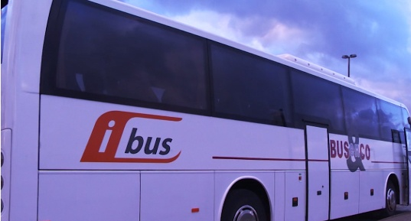

Specific actions on access to work
20% of households don’t own a car
  Specific problems with recently arrived people
Training of people in search of work and employment workers
  Orientation in the city / how to use public transport / reach working destinations
Specific transport facilities
  Bus to Zeebrugge port
  I-bus to Antwerp chemical industry
  Max Mobiel (Ghent):
    bicycles
    shuttle services to Ghent Port

Slide 10
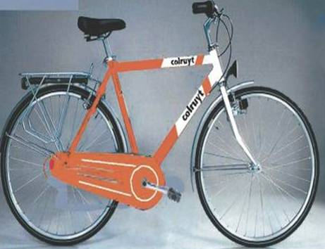
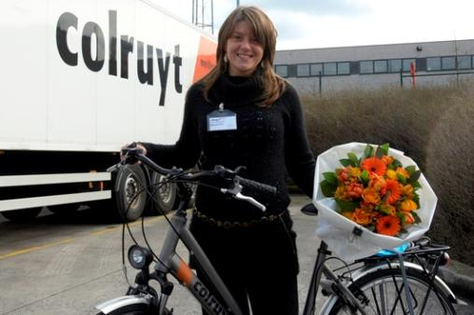
Case: “Bike to work” plan
Colruyt supermarkets
free bicycles for home-work travel, combined with km fee for cyclists
in a broader sustainability commitment including also active carpool policy and reduction of freight emissions
→Bike use from 8 to 14% in modal split
→Access to work also for personnel without a car

Slide 11
Case: Nike logistics Europe
Rural environment with no public transport (average 2000 emp.)
Subsidized by commuter fund
Intensive promotion of carpooling through reserved parking spaces, fiscal advantage, awareness campaigns: almost 50%

Slide 12
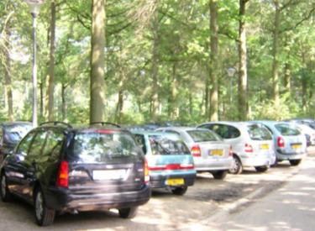
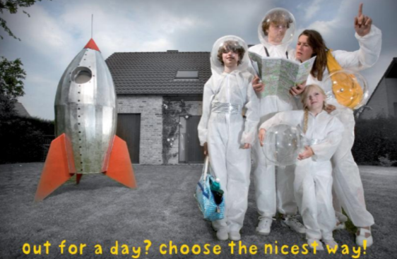
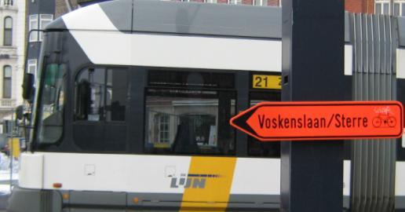
Extension of mobility management
To other trip purposes
Leisure trips (46% of all trips in Belgium)
  congestion spreads outside peek hrs
  destinations lose quality because of number of cars
  mobility management decreases impact on the environment and the quality of leisure time
Road/infrastructure works
  An opportunity to promote alternatives
  Avoid unnecessary detours by cars

Slide 13
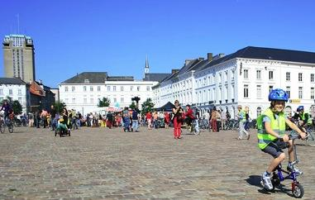
Extension of mobility management
To other trip purposes
Integration in sustainable (urban) mobility plans
  consultation and information/ working with companies, schools etc…
  cycle and public transport infrastructure
  parking management: from minimum to maximum requirements
Flanders:
  Mobility contracts between regional authority and municipalities
  If the municipality makes a mobility plan according to certain standards of sustainability, it receives subsidizing by the region
  One of the topics for which subsidies are possible is “working with target groups”

Slide 14
Thank you for your attention
Questions? traject@traject.be

