Slide 1

Action for Rail: building alliances beyond the trade union movement
ETUC Green Workplaces
7 May 2013
Brussels

Slide 2
3 barriers to an accessible and sustainable railway
Privatisation
McNulty Review
  Cuts to jobs and services
  ‘more commercial freedom’ for train operators
Fare rises

Slide 3





Action for Rail

Slide 4
2 key aims:
Promote the case for an integrated national railway under public ownership.
Minimise the impact of government and industry proposals.

Slide 5
5 Key Objectives:
Establish a joint union campaign, under a common brand
Build dynamic relationships with civil society partners, community groups and passengers
Engage and inform MPs, Ministers, councillors and relevant civil servants
Work with relevant industry bodies and representatives
Establish a credible, evidence-based and accessible media presence, including social media

Slide 6
Build dynamic relationships with community groups and passengers
Passengers at stations
Women’s groups
Disabled and older people’s groups
Climate campaigners

Slide 7
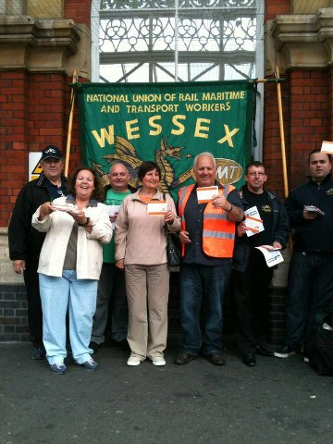
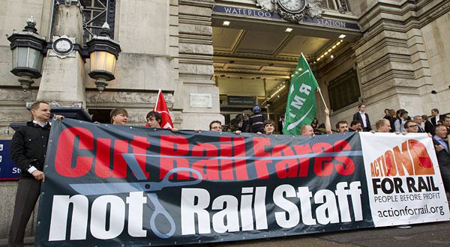
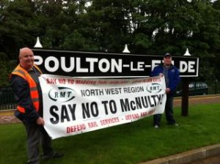
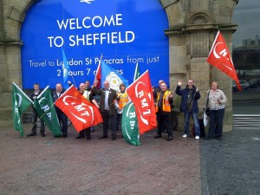
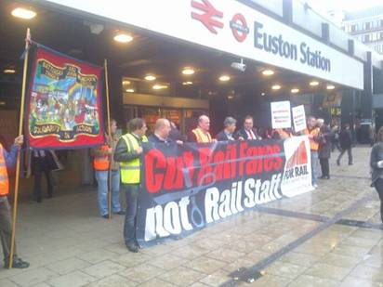
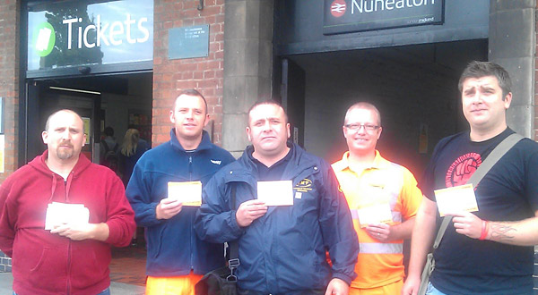
Days of action

Slide 8

Passengers at stations ...

Slide 9
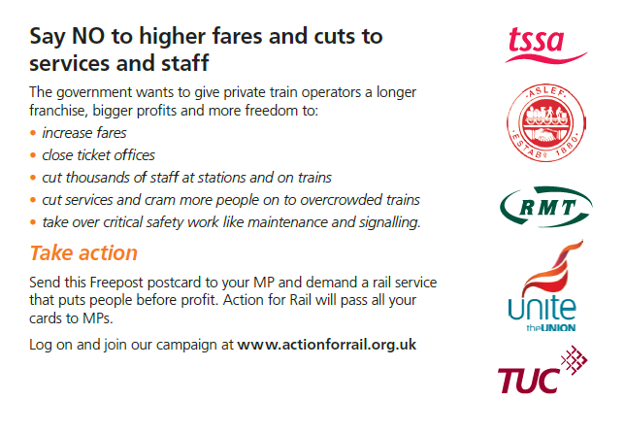
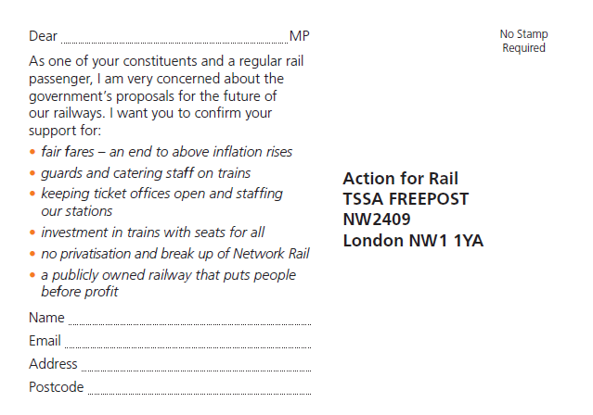
Passengers at stations ...

Slide 10
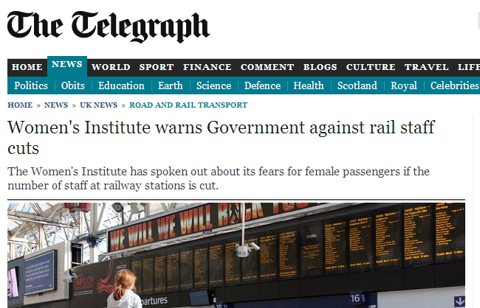
Women’s groups ...

Slide 11

Disabled and older people

Slide 12
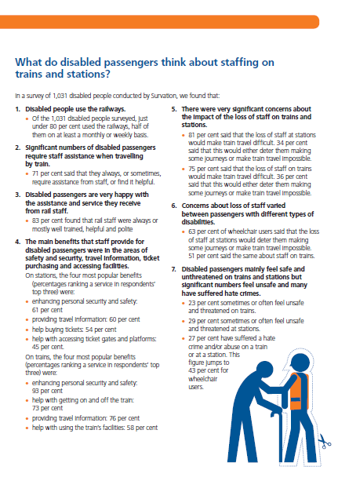
Disabled and older people ...

Slide 13

Disabled and older people ...

Slide 14
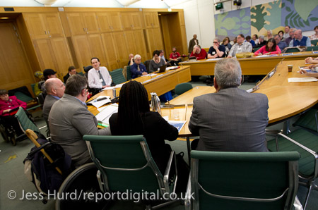
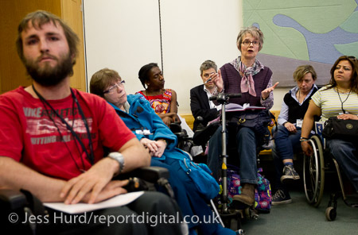
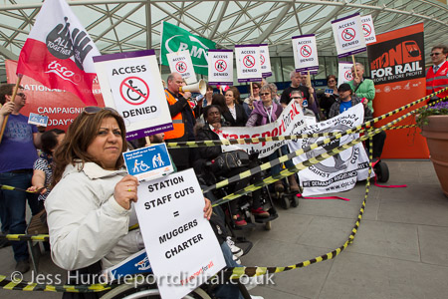
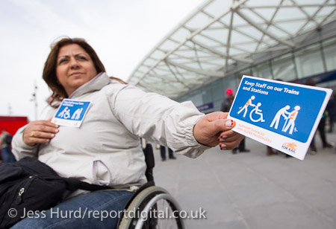
Disabled and older people ...

Slide 15
Together for Transport
http://www.togetherfortransport.org/farefail/

Slide 16
Media response

Slide 17
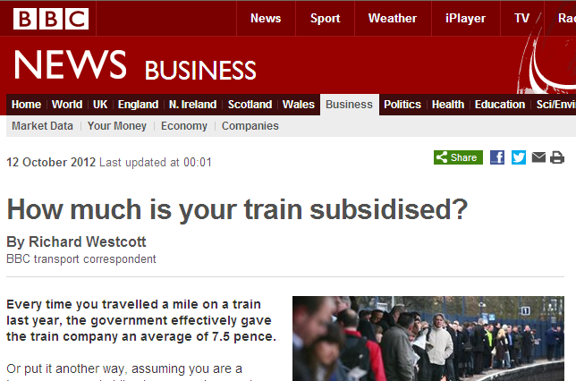
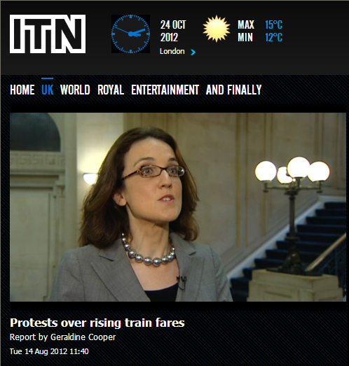
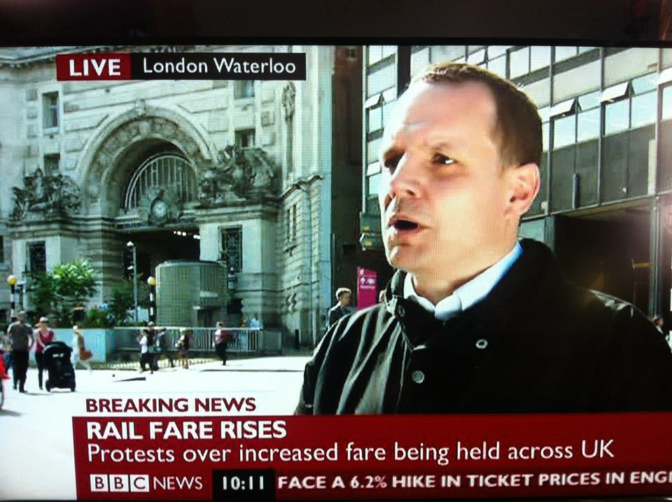
Establish media presence - TV

Slide 18
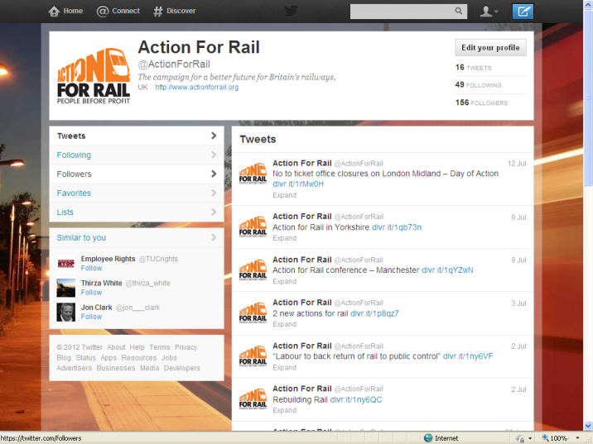
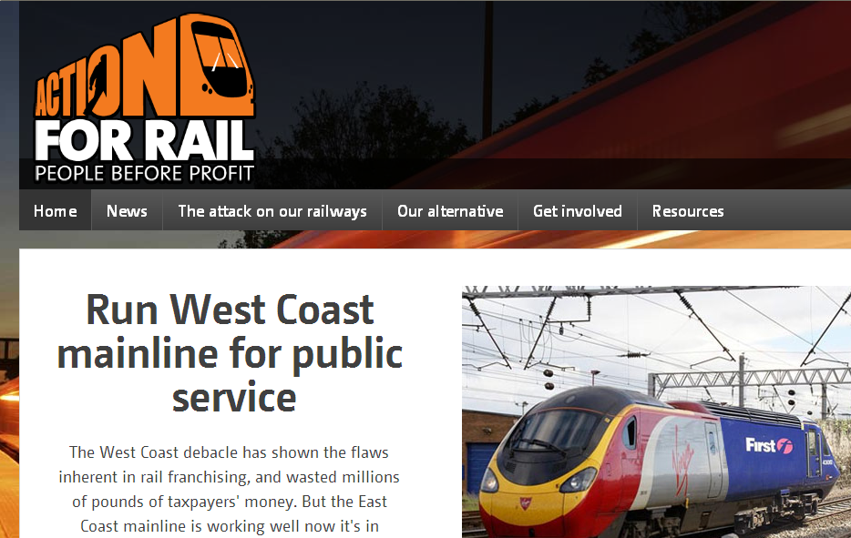
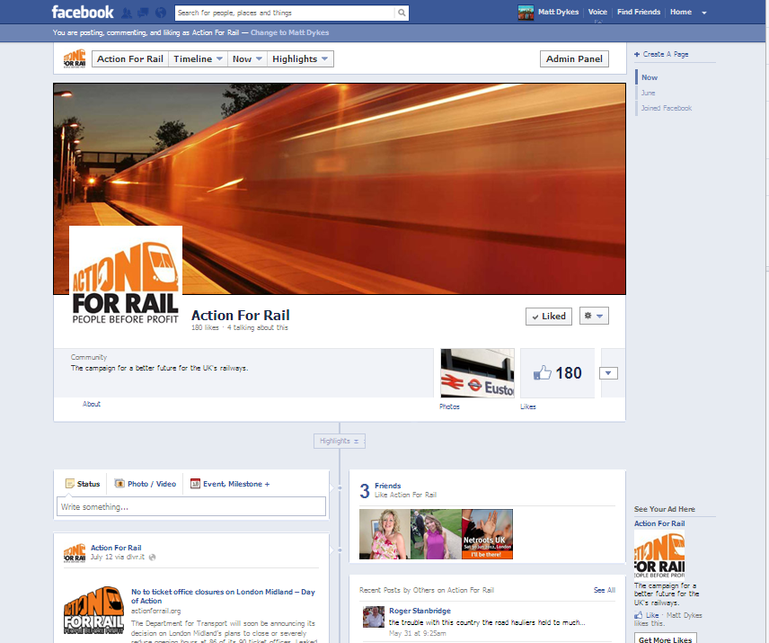
Digital Media

Slide 19
Advantages:
Leverage
Coverage
Messages
Capacity
Credibility and legitimacy

Slide 20
Disadvantages:
Resources
Usual suspects
Messages
Control
Tensions

Slide 21
Lessons
Learn to let go
Limits to leverage
More or less capacity / resources?
Anticipate tensions and scepticism
Deep & narrow v shallow & broad
When it works – it is very effective!

Slide 22
Further information
mdykes@tuc.org.uk
www.actionforrail.org

