Slide 1
Mobility through Union action
Charles-Etienne Jamme
SETCA delegate at SWIFT
Notes:
SWIFT Training
Our knowledge, your solution.
www.swift.com/training

Slide 2

At the beginning there was …
Personal motivation factor
  Bicycle
  Environmental consciousness
The global view : all transport modes
You shouldn’t pay more than your time to commute to work
Convincing others
  Leading by example
  Spreading the word to the “Corporate Authorities”

Slide 3

The confrontation time
Part I : towards radicalisation
NO WAY from HR
Promises from other unions
Call for action
  Communicate, Communicate, Communicate
  Flyers
  Internal Newsgroups
Path of No Return : 2008
  Enlisting on a Union for the social elections

Slide 4
The confrontation time
Part II : finding allies
Elections results
  only representative elected from SETCA
  high personal score
Other Unions greetings
  Huge support from some members (CNE – Peter Billington)
  Push back from others
Repetitive topic at the Agenda of both Health and Safety committee (CPPT) and Work Council (CE)
CSR team is your friend

Slide 5

The confrontation time
Part III : finding information
Who else is active in Mobility?
  GRACQ & ProVelo
  RISE
  Greenpeace
  Newspapers
What has been achieved in other corporates?
  DEXIA CCT (Collective Bargain Agreement) : the reference
  Colruyt mobility example
Consolidation in a mobility plan

Slide 6
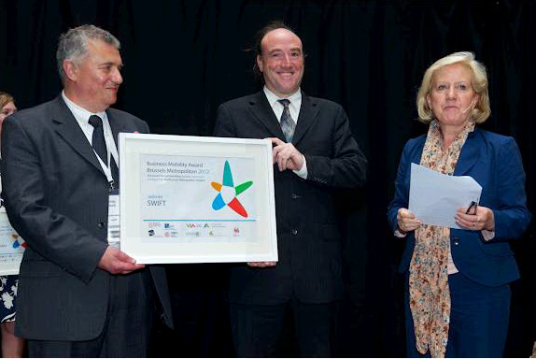
After 4 years of implementation
SWIFT Mobility Offering
Public transports
Private shuttles
Bicycles
Carpooling
Flexible car policy
Flexible work time
Work from home
In 2012 SWIFT received the Business Mobility Award

Slide 7
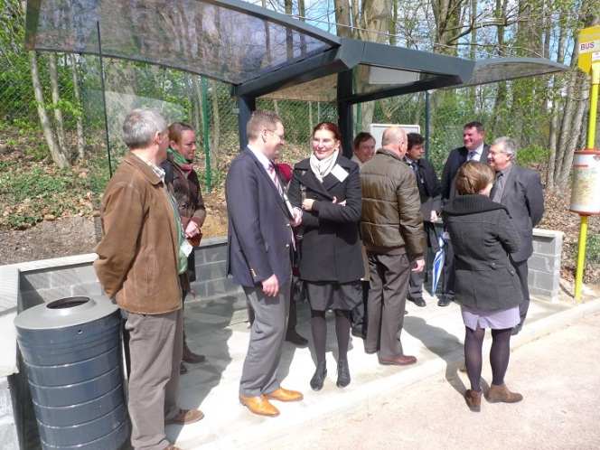
SWIFT Mobility Offering
Public Transports
Free Train subscription
  Combined with STIB/MIVB
Free Bus subscription (TEC/De Lijn)
SWIFT shuttle buses
  La Hulpe train station (Ottignies)
  Direct from/to Brussels
SWIFT bus shelter

Slide 8
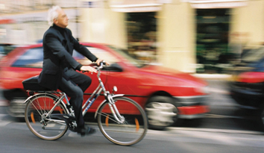
SWIFT Mobility Offering
Bicycles
Facilities
  Showers, changing rooms, lockers
Bicycle parking places close to building entrances
Bike to Work intervention : 0,21 €/km
Bicycle repair stations
Electric bicycles
Bicycle reflective jackets

Slide 9
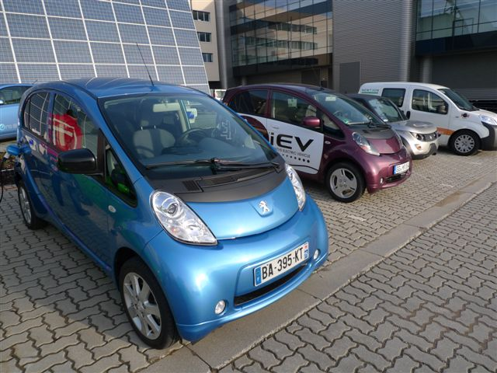
SWIFT Mobility Offering
Cars
Flexible car policy
  Opt Out for Level 60 and above
  Mobility budget
    Bicycles
    Motorbike
    Tablet
    Railease
Carpooling
  Carpool Plaza subscription (2010)
  Carpool parking places
  Web 2.0 technologies (2013)

Slide 10

First we need to decide what needs to be done
Then we’ll do it
And then we’ll ask if it was possible.
Paul Hawken, 2009

